Slide 1
Renewable energies
Ins Teresa Pàmies
Notes:
SimoSimo

Slide 2
Summary
Renewable energy
Renewable energy sources in Spain
Renewable energy sources in Catalonia
Notes:
LaiaLaia

Slide 3
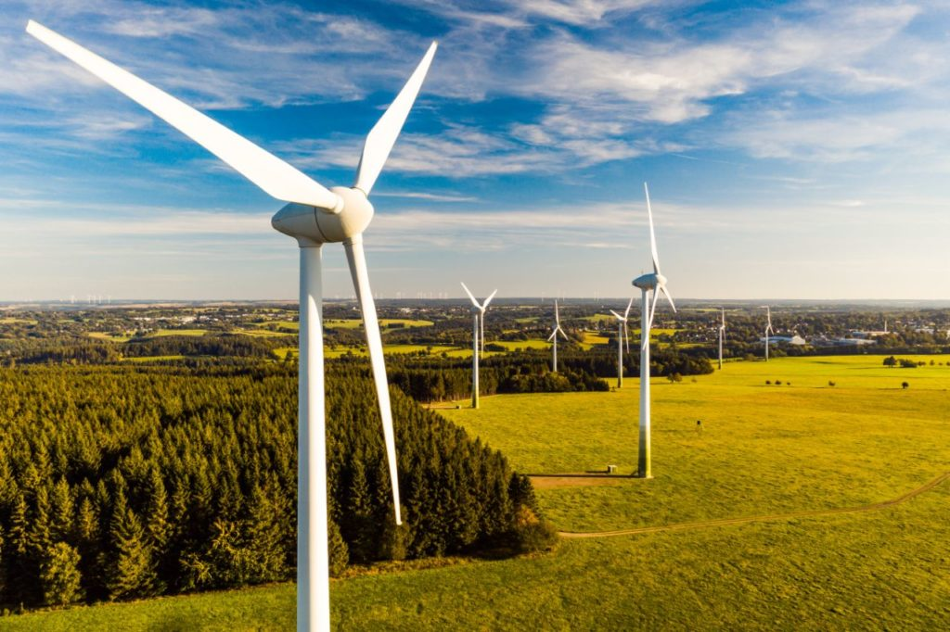
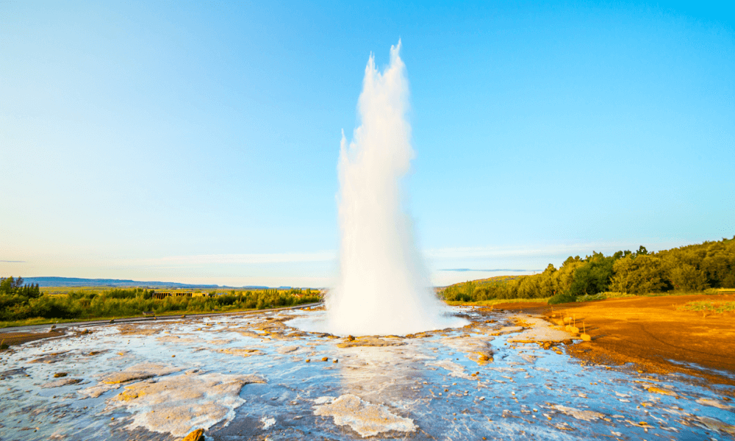
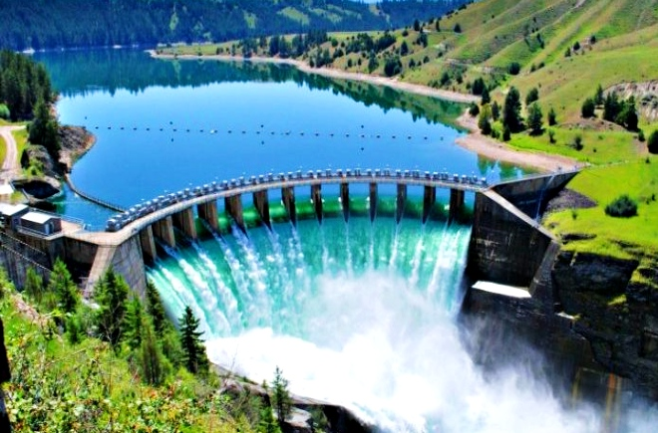
Renewable sources
Solar energy
Wind energy
Geothermal energy from heat inside the earth.
Biomass from plants
Hydropower from flowing water
Notes:
Inés

Slide 4
Renewable energies in Spain
In 2020:
Renewable 45.5%
Non-renewable 54.5%
Notes:
mar

Slide 5
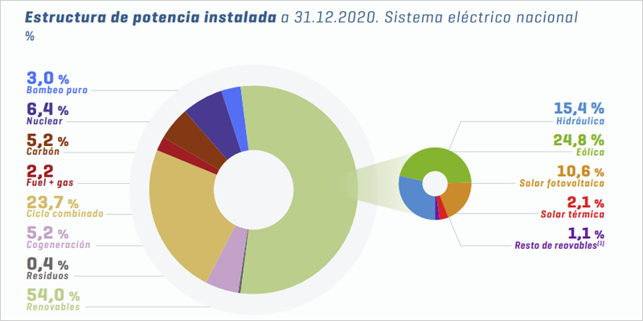
Generation record of renewable energy installations in Spain
In Spain (2020) the 54% of the energies new installations have been renewables.
From the 100% installations…
15.4% hydroelectric
24.8% wind power
10.8% photovoltaic solar power
2.1% thermal solar power
1.1% other
Notes:
christian

Slide 6
Renewable energies in Spain
In 2020 Spain has reached its record in renewable sources production
Every year we are decreasing the use of coal a 16%
The intention for 2030 is to have 74% of renewable production, by duplicating wind power and three times solar energy.
Final objective in 2050: Have 100% renewable energies.
Notes:
simó

Slide 7
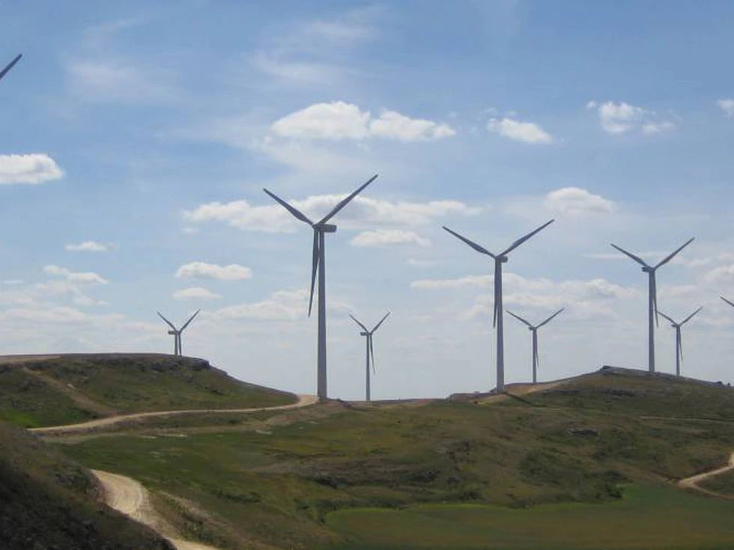
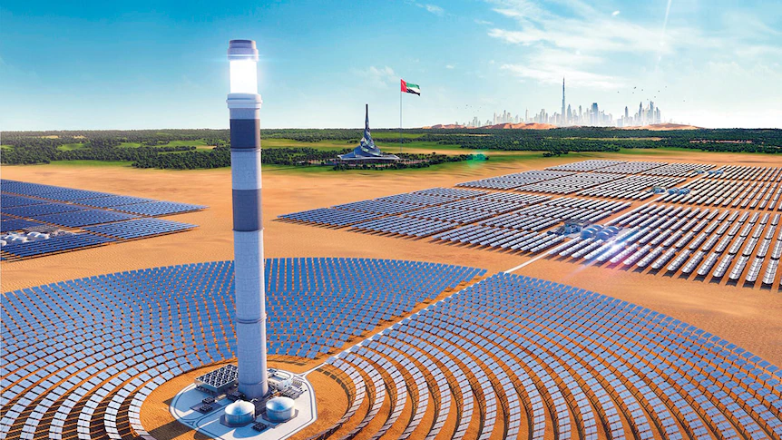
Renewable energies in Spain
Solar thermal energy is actually more used than photovoltaic panels because it is more efficient.
You can also see a lot of wind turbines in the Spanish countryside, as wind power is very used.
Solar power is very valued here as it is a very warm country, but it still isn't used at its full potential because of its cost and current low electrical efficiency.
Notes:
clara

Slide 8
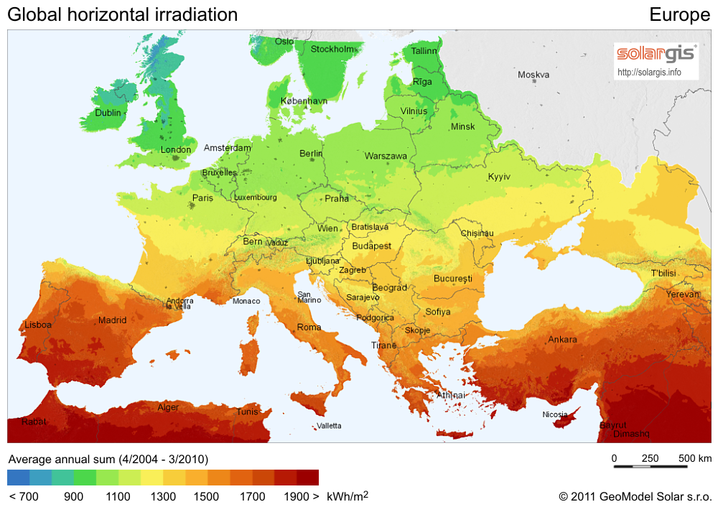
Renewable energies in Spain
As a more southern country Spain can benefit better from the solar power than other countries in Europe.
Notes:
christian

Slide 9
The number of installations of photovoltaic solar panels has increased in Spain over the past few years.
Notes:
laia

Slide 10
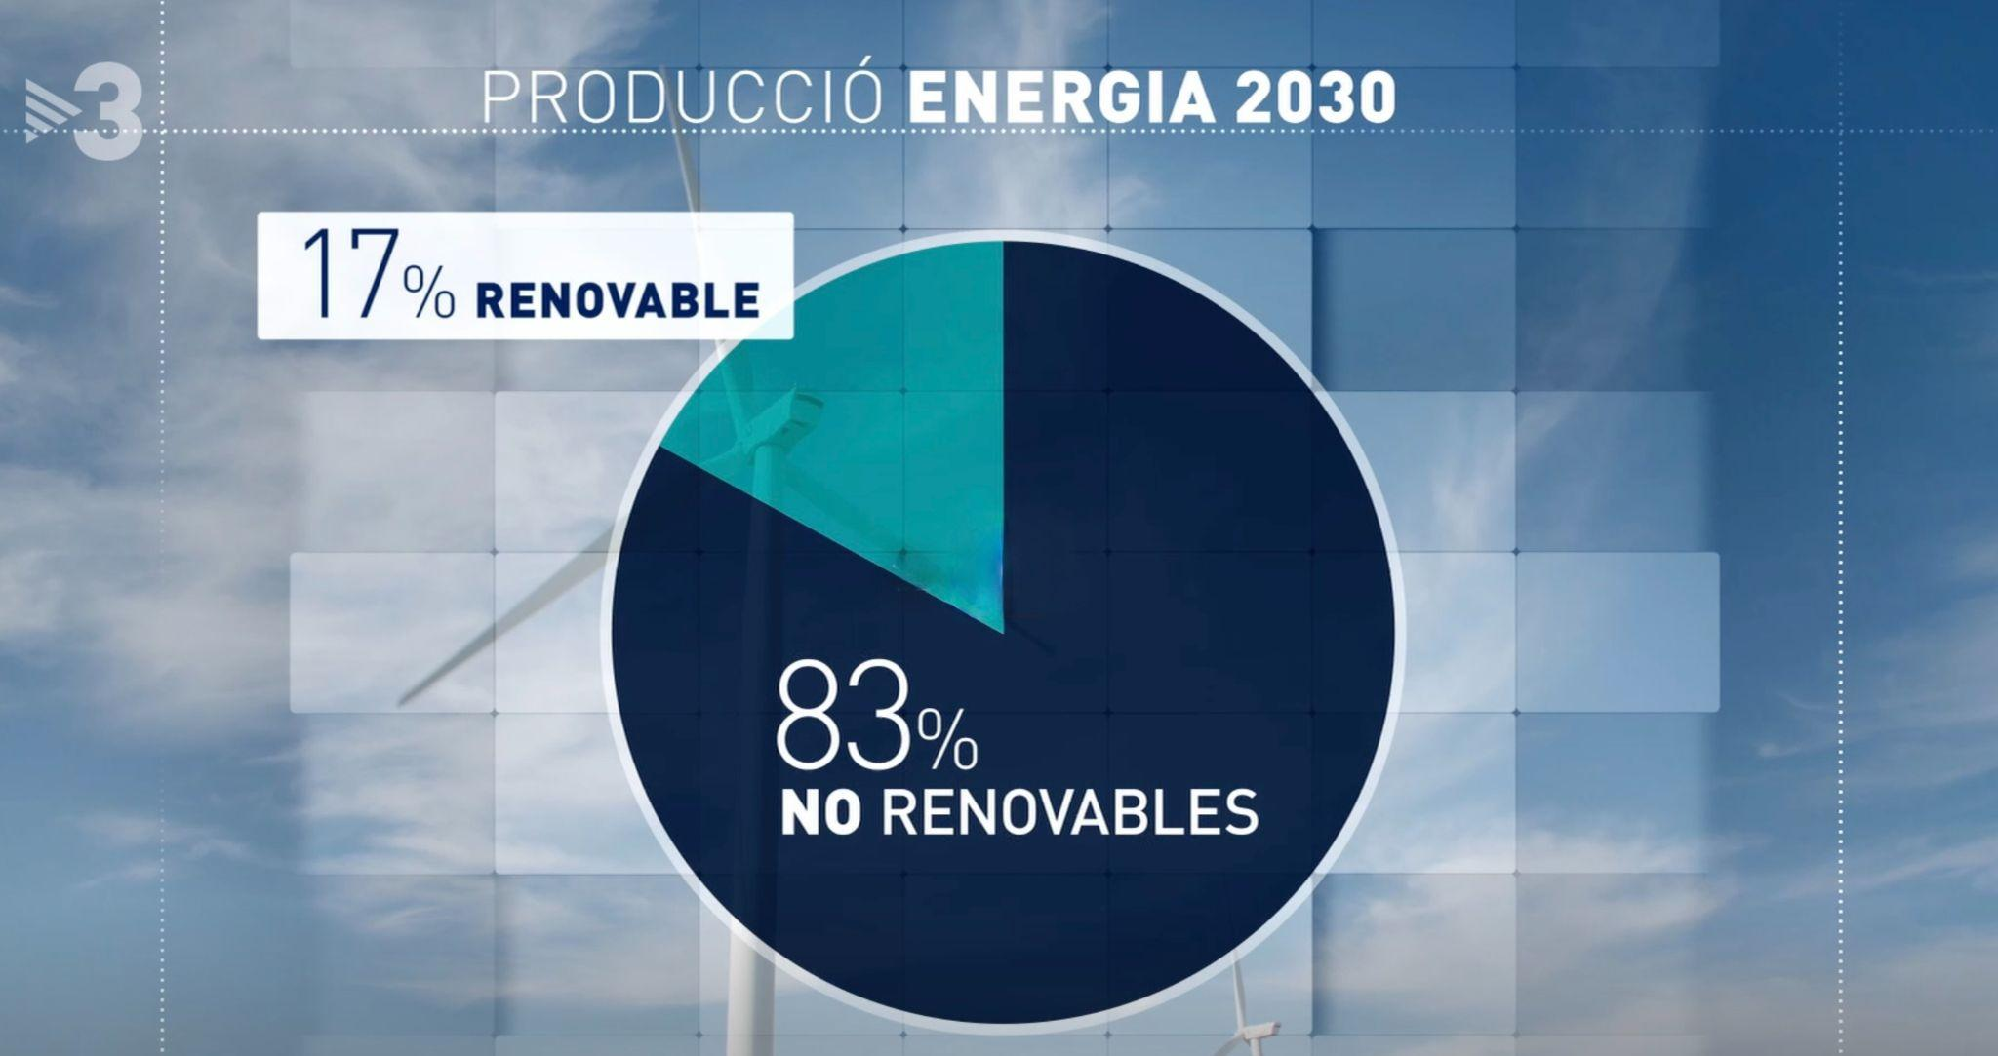
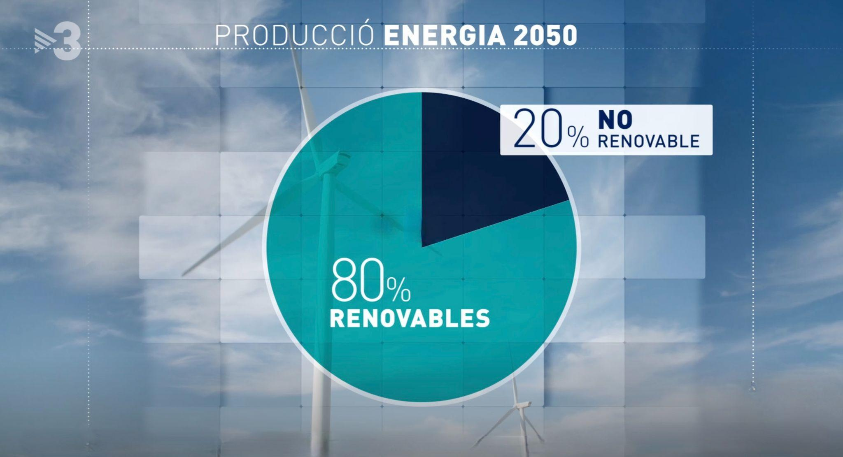
Renewable energies in Catalonia
Expected energy production in Catalonia by 2030
Expected energy production in Catalonia by 2050
Energy consumption in Catalonia 2019
Notes:
Inés &mar

Slide 11
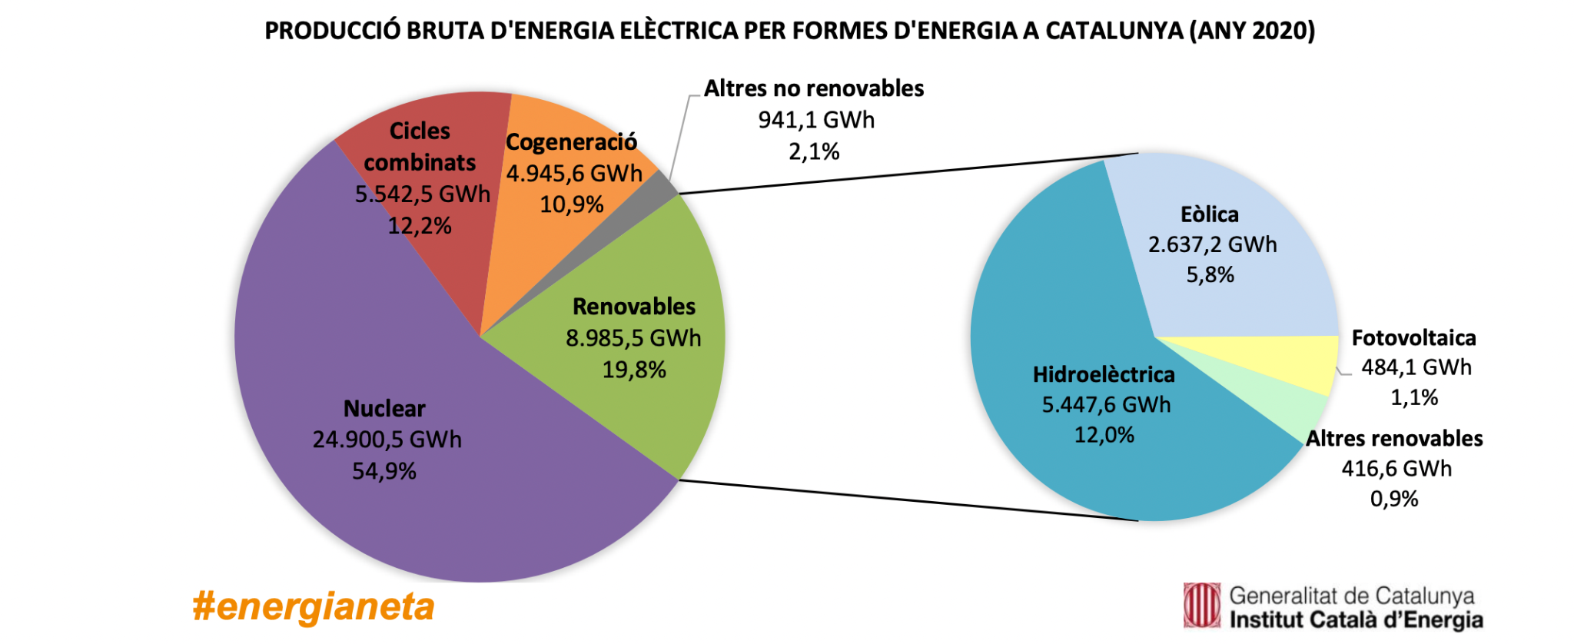
Renewable energies in Catalonia
Gross production of electric energy by energy sources in Catalonia (2020) - Generalitat de Catalunya, Institut Català d’Energia
Notes:
Simo & laiaSimo & laia

Slide 12
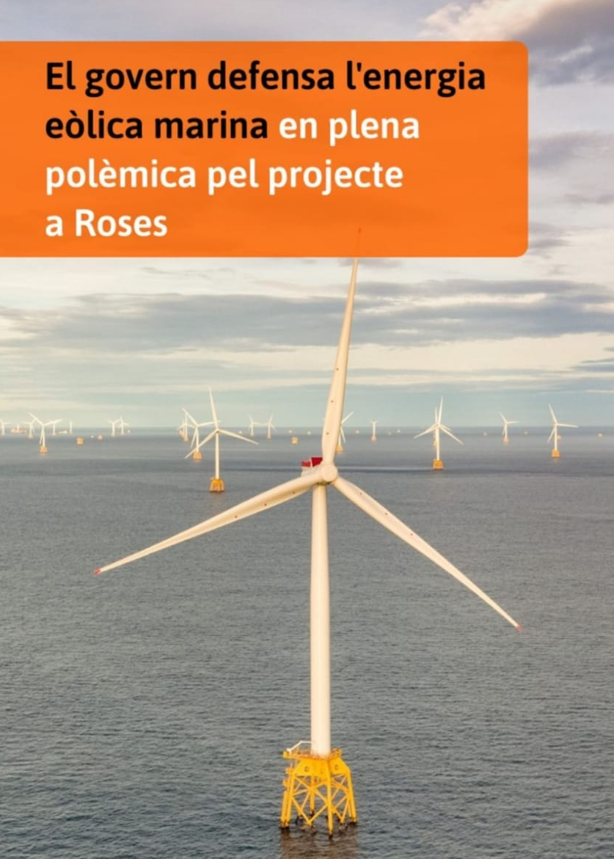
Wind power in Catalonia
The Government is defending offshore wind energy amid controversy over the project in Roses
It’s mostly concentrated on the south because there’s more wind there
It brings a lot of controversy because most of it is owned by a single company that dominates the market and they don’t employ local people.
Notes:
clara

Slide 13
THE END
Thanks for listening!
Notes:
LaiaLaia

