Slide 1
RENEWABLE ENERGY IN TURKEY

Slide 2
INTRODUCTION
Renewable energy,often referred to as clean energy,comes from natural sources or processes that are constantly replenished.

Slide 3
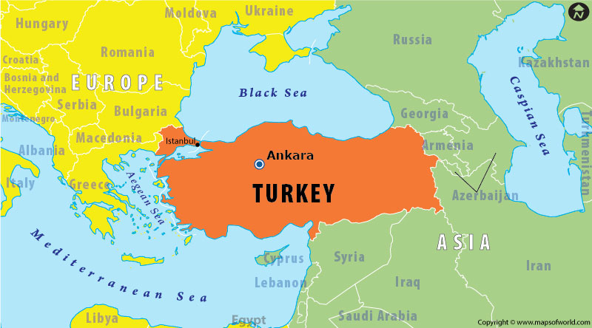
.
Turkey is located on the Western Asia and Southeast Europe. Turkey also has a coastline on the Mediterranean Sea in the South and East and on the Black Sea in the North.
.

Slide 4
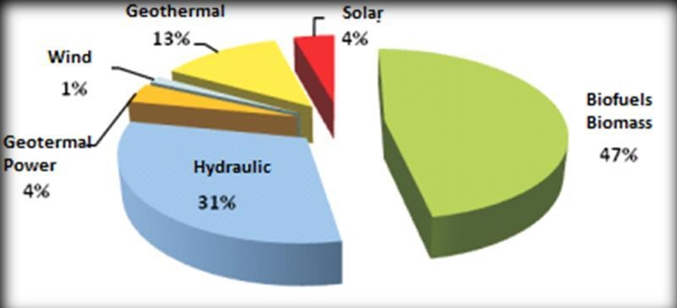
.
Our country’s significant location provides several advantages for renewable sources such as solar energy, wind energy, hydroelectricity, geothermal energy and biomass energy.

Slide 5
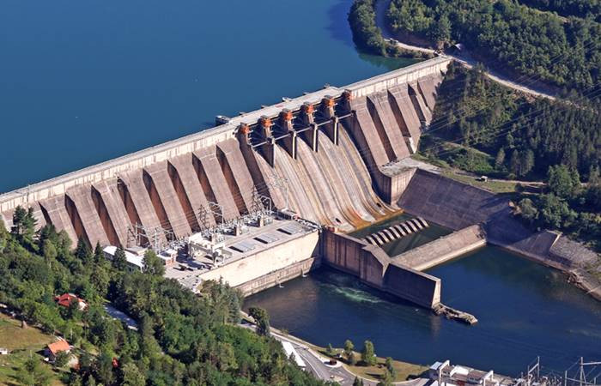
.
HYDROELECTRIC ENERGY
Hydroelectric energy, also called hydroelectric power or hydroelectricity , is a form of energy that utilizes the power of water in motion such as water flowing over a waterfall , to generate electricity.

Slide 6
Hydroelectricity is a critical source of energy in Turkey and substantial amounts of it can be generated due to Turkey’s mountainous landscape , abundance of rivers , and its position surrounded by three seas . According to the International Hydropower Association Turkey is the World’s ninth largest producer of hydroelectricity in 2020 . The main river basins are the Fırat and Dicle.

Slide 7
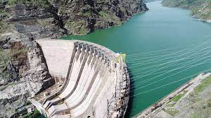
Some examples from Turkey:
Atatürk Dam
Keban Dam

Slide 8
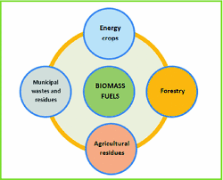
BIOMASS ENERGY
Harnessing natural energy has become the focus of scientists in an effort to reduce the dependance on fossil fuels and find a safer and cleaner alternative source of energy.

Slide 9
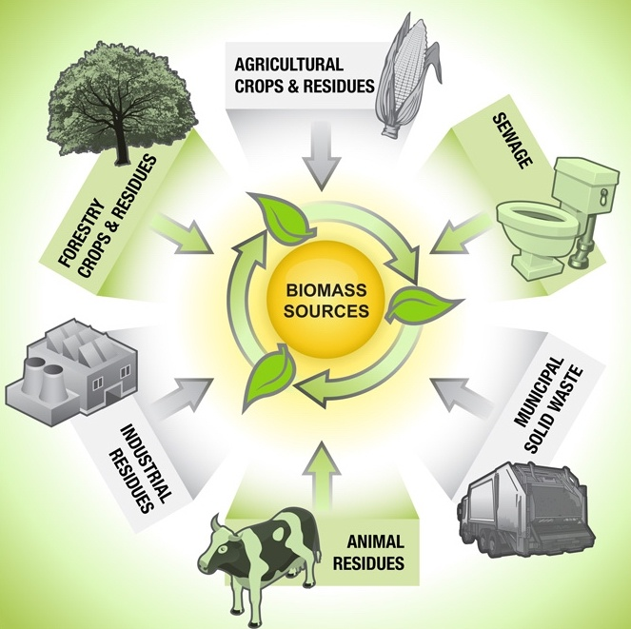
Wood and wood residues is the largest biomass energy sources. Today wood can be used as fuel directly or processed into pellet fuel or other forms of fuels other plants can also be used as fuel , for instance corn , switchgrass , miscanthus and bamboo

Slide 10
Advantages of biomass energy | Disadvantages of biomass energy
it is renewable | it’s not completely clean
carbon neutrality | high costs in comparison to other alternatives
less dependency on fussel fuels | possible deforestation
it is versatile | space
availability | it requires water

Slide 11
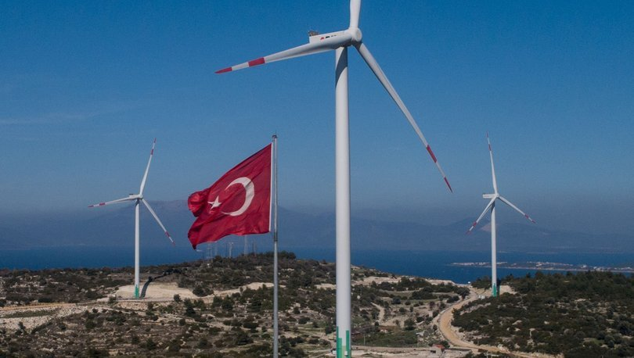
.
WIND ENERGY
Wind is renewable , clean and endless power that generates no pollution.
As the name suggest , wind energy or wind power is the process whereby wind is use to generate electricity.

Slide 12
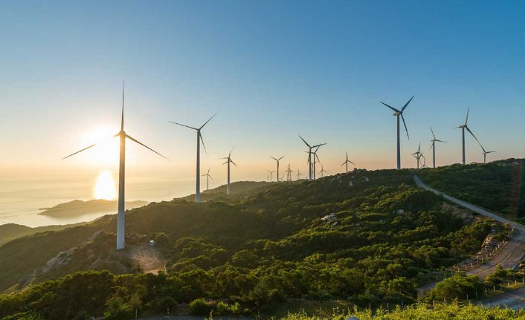
Wind turbines convert the wind’s kinetic energy into mechanical energy. A wind farm is a collection of wind turbines in the same location to generate electricity.

Slide 13
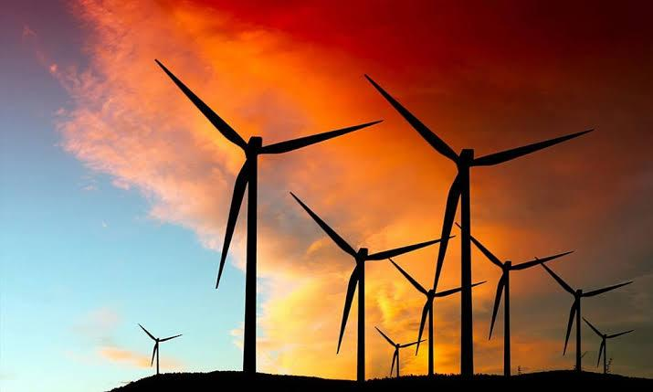
Wind energy is the second most used energy source in Turkey. Electricity generation with wind power in Turkey started in 1998.
Wind turbines in Turkey are generally located in the West of Turkey.
Turkey’s highest plant is in Van province.

Slide 14
Advantages of wind power | Disadvantages of wind power
nonpolluting way to generate electricity | constructing turbines is expensive
reduces carbon emissions | Turbines can damage the habitats of animals
Turbines are portable | generates a lot of noise

Slide 15
SOLAR ENERGY
Solar energy is energy from the sun , it can be harnessed directly from the sun , even in cloudy weather. It is the most abundant energy resource on earth.

Slide 16
Flat Plate Collectors
Among the most common devices used to capture solar energy are flat plate colectors which are used for either heating or creating electricity.

Slide 17
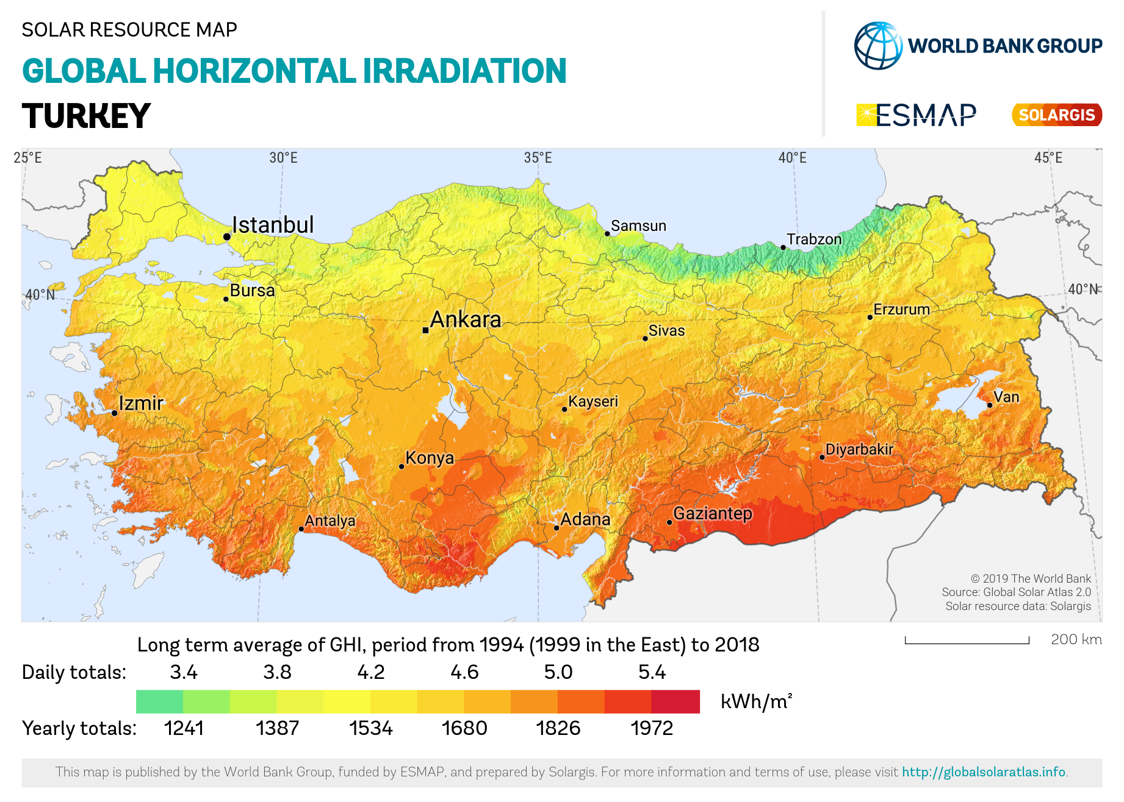
Solar potential is very high in Turkey especially in the South Eastern Anatolia and Mediterranean provinces.

Slide 18
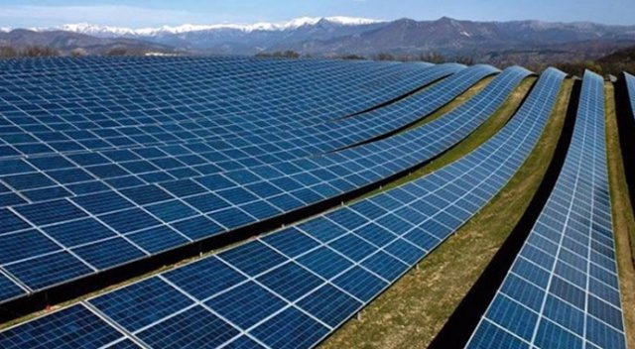
Karapınar Solar Plant
In an attempt to increase the use of solar energy , the Karapınar Solar Plant was built in Konya province located in Anatolia.

Slide 19
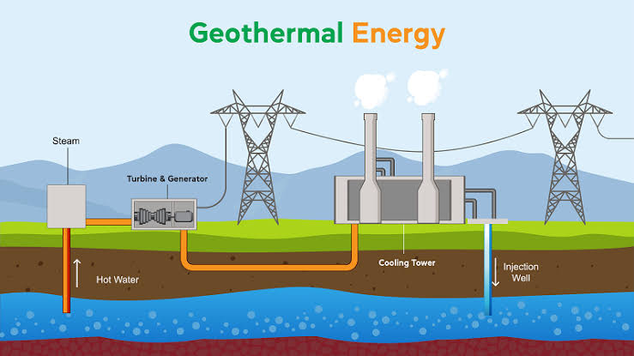
GEOThERMAL ENERGY
Geothermal energy is heat within the earth. It comes from heat generated during the original formation of the planet and the radioactive decay of materials.

Slide 20
The Use Of Geothermal Energy
Geothermal power plants use steam to produce electricity. The steam comes from reservoirs of hot water found below the earth's surface. The steam rotates a turbine that activates a generator, which produces electricity.

Slide 21
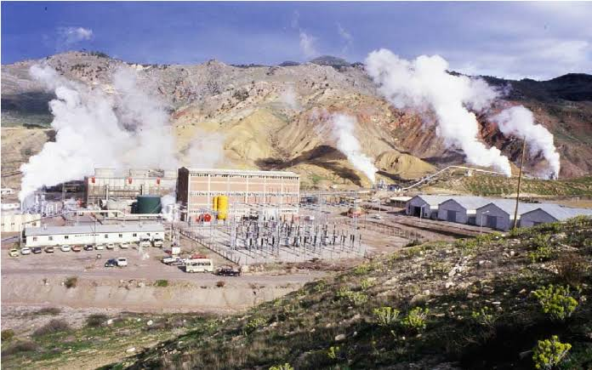
Geothermal Power Plants In Turkey
Turkey currently has 55 geothermal power plants and 17 geothermal city heatings. About 450 geothermal fields have been discovered. Turkey's biggest geothermal power plant is in Kızıldere.

Slide 22
THANKS FOR your attentıon!

