Slide 1
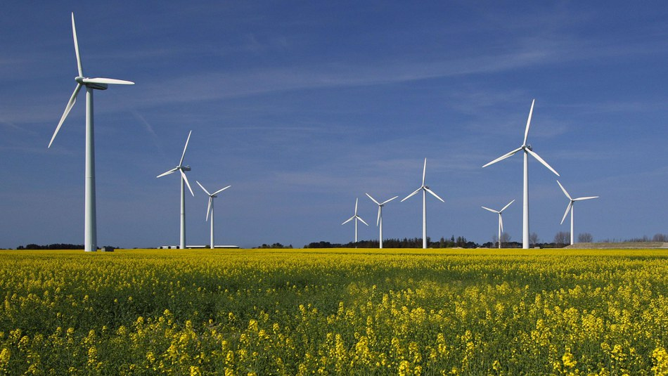
Renewable energy in Poland

Slide 2
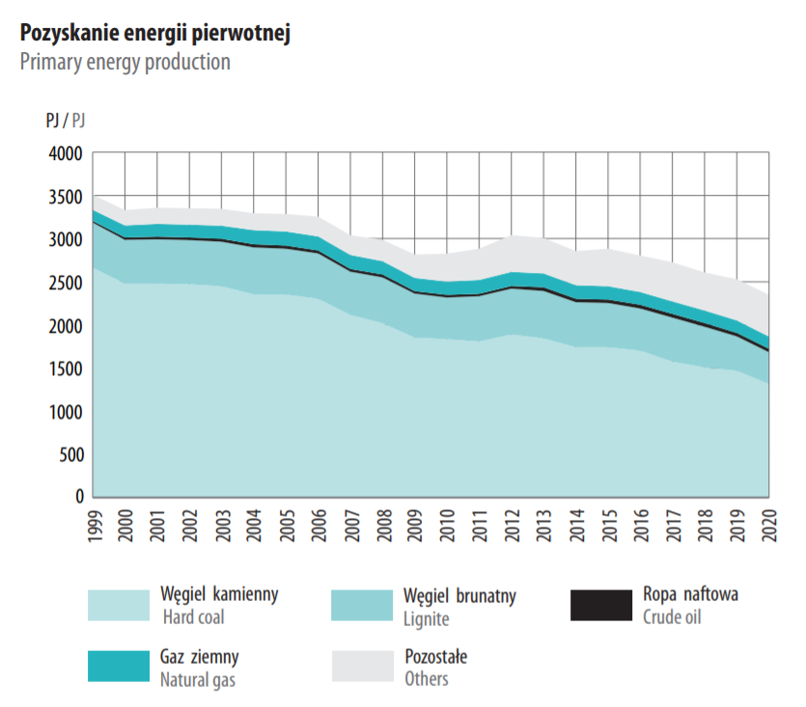
Poland's energy balance
Energy production in 2020: 158 TWh
Energy demand in 2020: 180 TWh
Almost 17% of energy used in Poland in 2021 came from renewable energy sources
(including renewable energy sources)

Slide 3
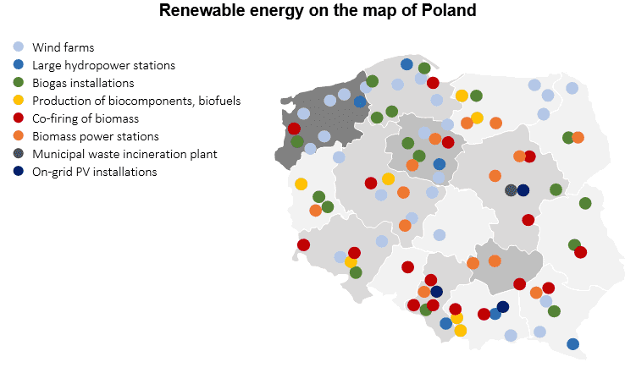
Renewable energy sources in Poland
Biofuels
Wind power
Hydropower
Solar power
Biomass
Biogas

Slide 4
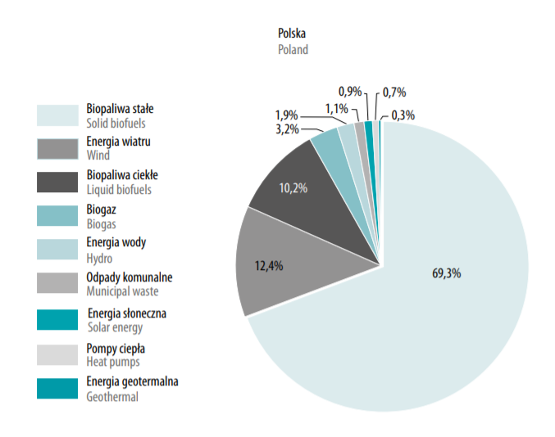
Renewable energy sources in Poland

Slide 5
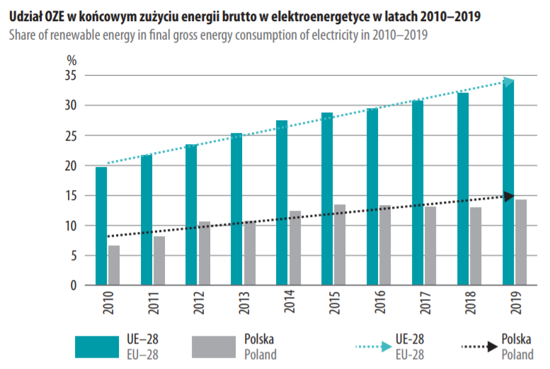

Slide 6
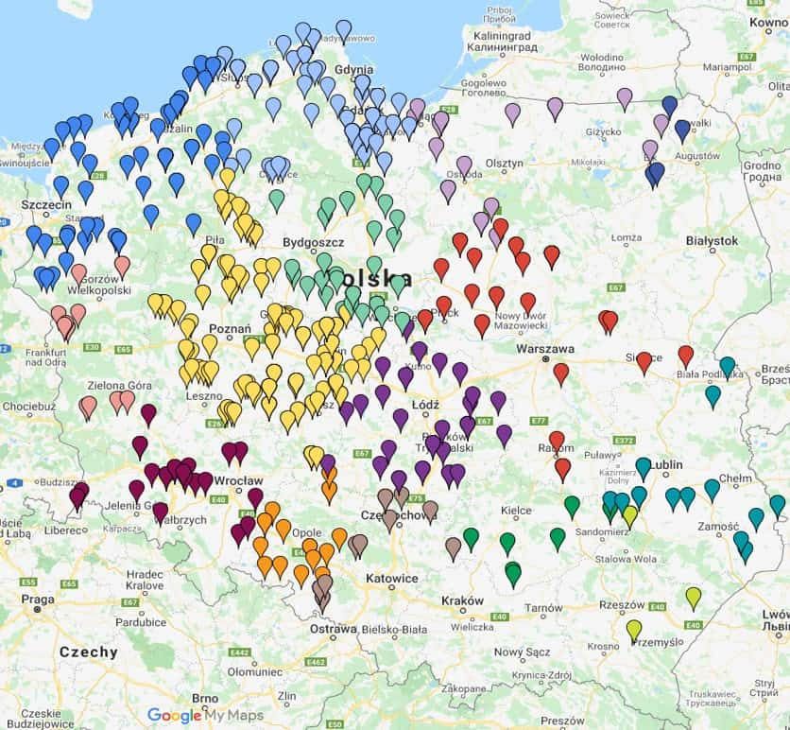
Wind power

Slide 7
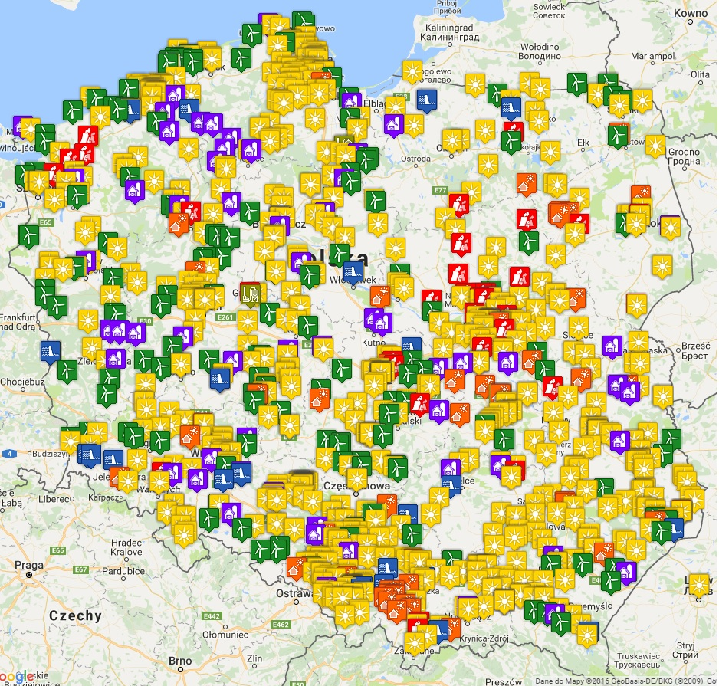
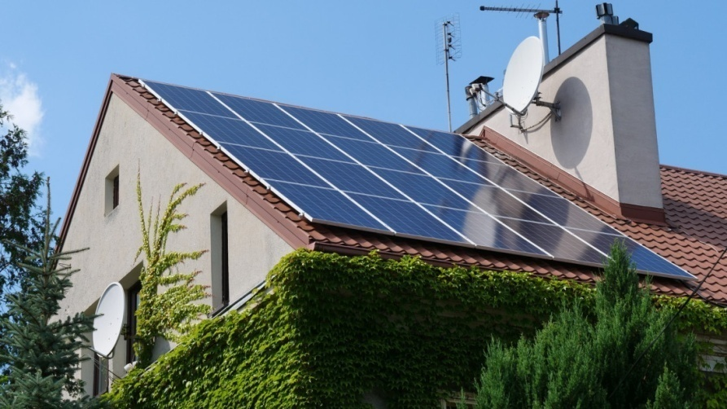
Solar power
Endowment for solar PV
PV power stations

Slide 8
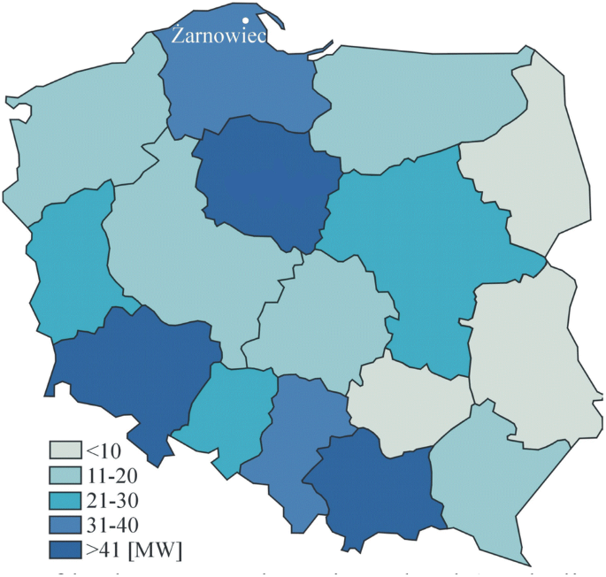
Hydropower

Slide 9
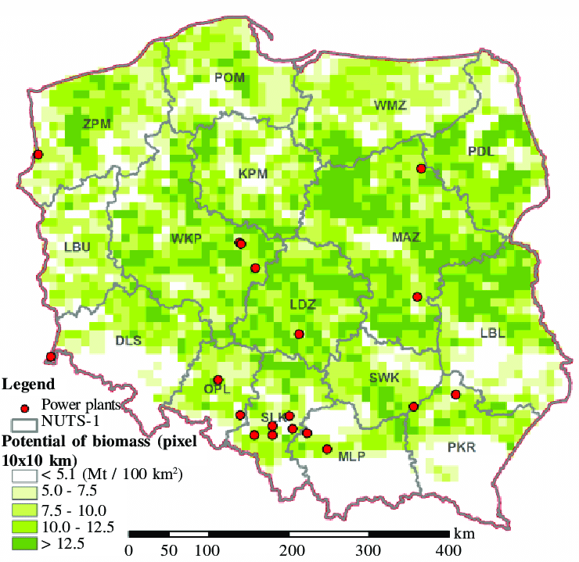
Biomass
Main sources in Poland:
Forestry
Agriculture
Biological and water vegetation
Municipal waste

Slide 10
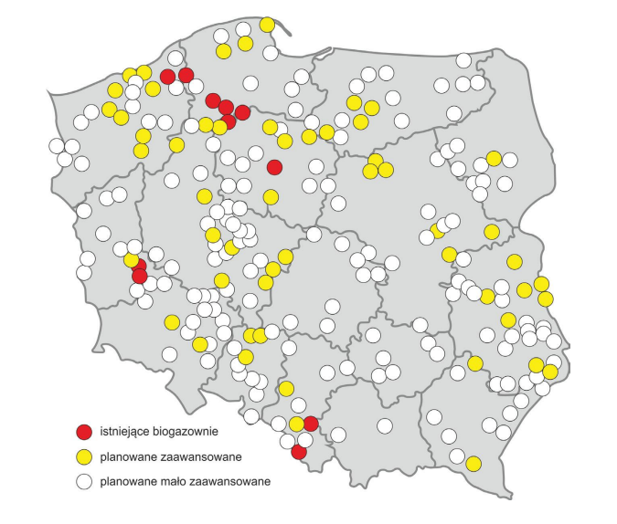
Biogas

Slide 11
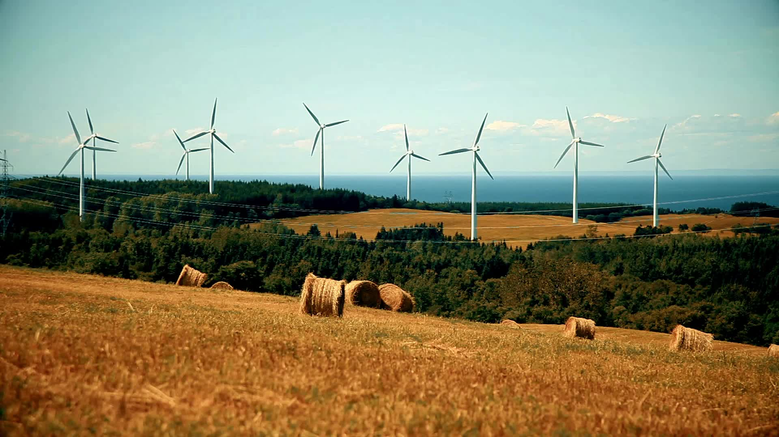
So far, the best year for renewable capacity increase was 2016. Its capacity at that time was 1446 MW.

Slide 12
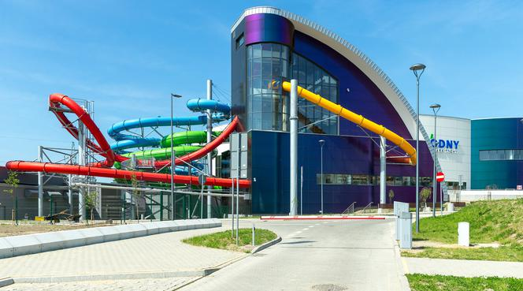
Renewable energy in our city
The aquapark is powered by biogas produced in local sewage works, which is then transported by an innovative gas pipeline to the aquapark, where electrical and heat energy is produced.​
Master is a company from Tychy that produces electric and heat energy from waste. It creates biogas, which can be used as a source of energy.

Slide 13
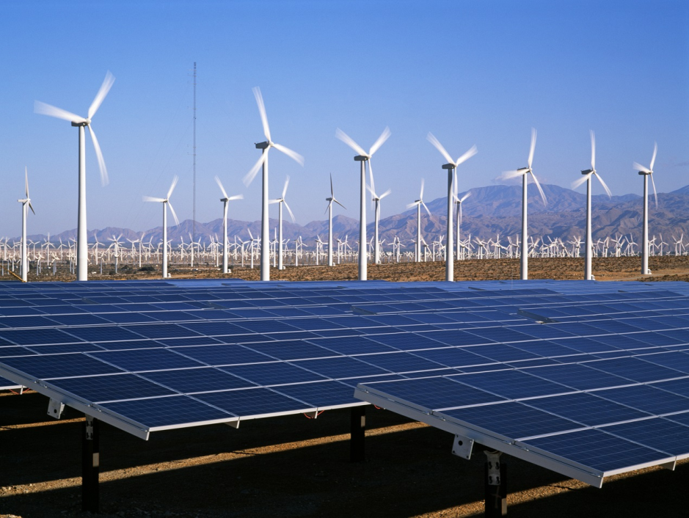
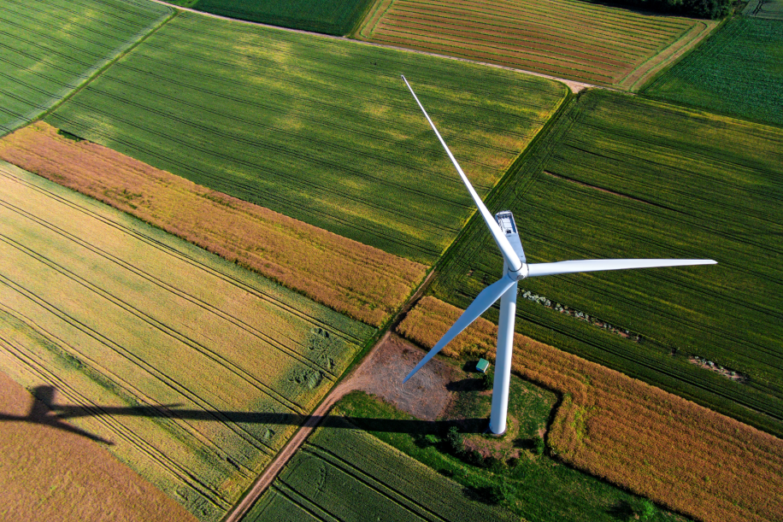
Poland is not at the forefront of the EU when it comes to statistics on the share of renewable energy in the energy production of the country as a whole. Slow development in this area is largely due to the reliance of the Polish energy sector and economy on fossil fuels. Despite this, a large increase in its share can be seen in recent years.

Slide 14
Sources:
Thank you for your attention!
https://stat.gov.pl/ https://www.forum-energii.eu https://www.flandersinvestmentandtrade.com/export/sites/trade/files/market_studies/2019-Poland-Renewable_Energy.pdf

