Slide 1
Renewable Energy

Slide 2
WHAT ARE RENEWABLE ENERGIES?
Renewable energies are energy sources that are not subject to depletion because they are naturally reintegrated in a human time scale through physical processes.

Slide 3
What would be the benefits?
- a low environmental impact
- fewer diseases caused by harmful gases
- slowdown of global warming
- a better future
Now let’s go to talk about the types of renewable energies.

Slide 4
Biomass energy
Solar energy
Hydroelectric energy
What are the renewable energy?
Wind energy
Geothermal energy

Slide 5
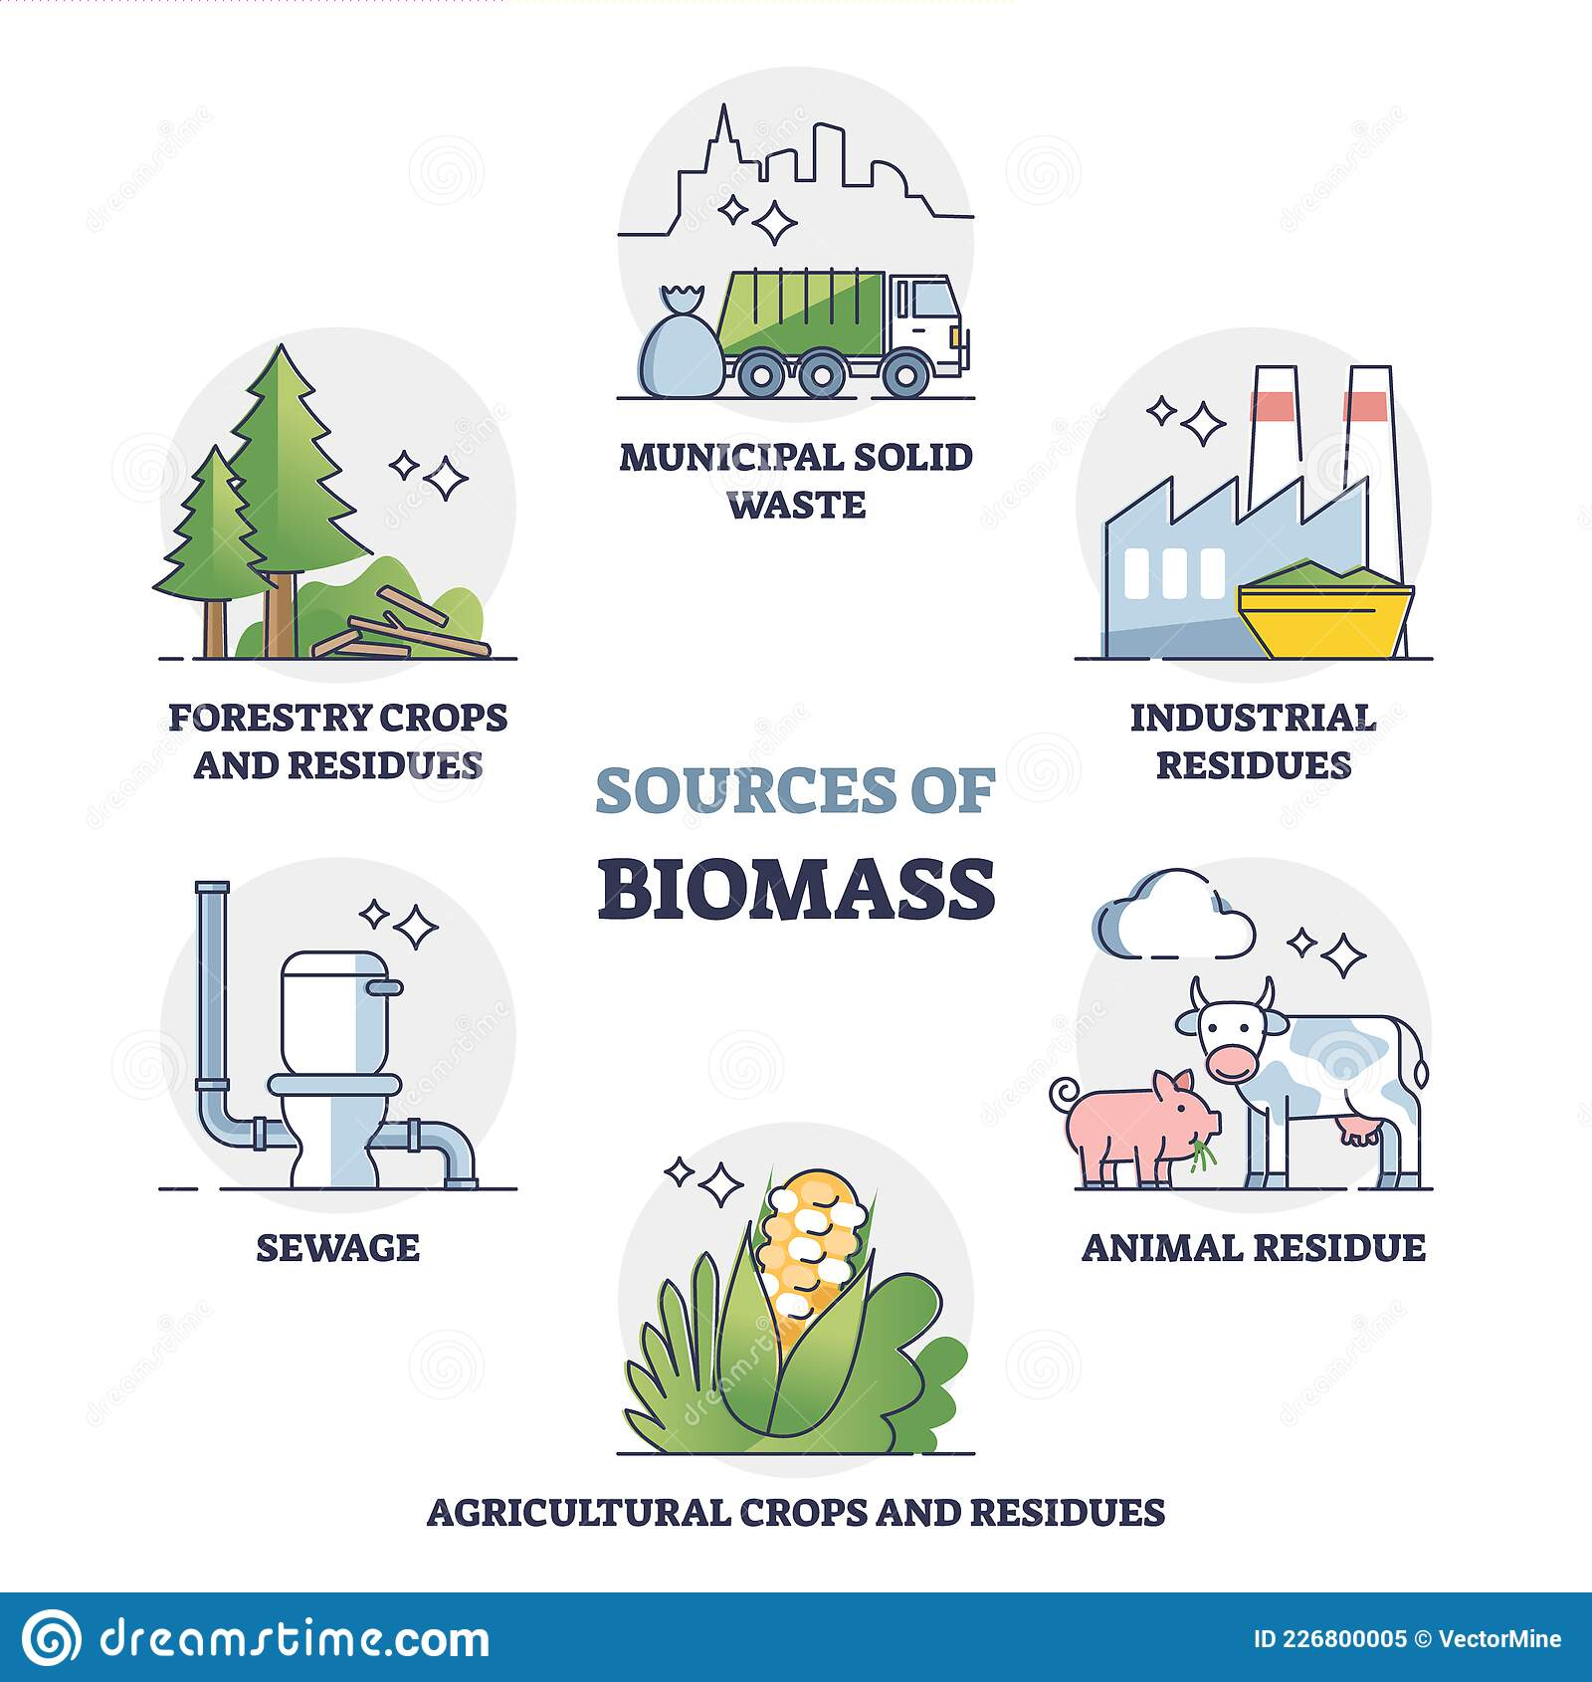
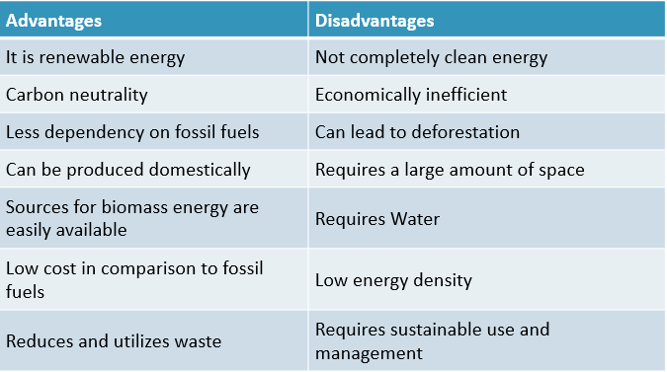
BIOMASS ENERGY
Biomass energy is energy generated or produced by living or once-living organism. The most common biomass materials used for energy are plants such as corn and soy. The energy from these organisms can be burned to create heat or converted into electricity.

Slide 6
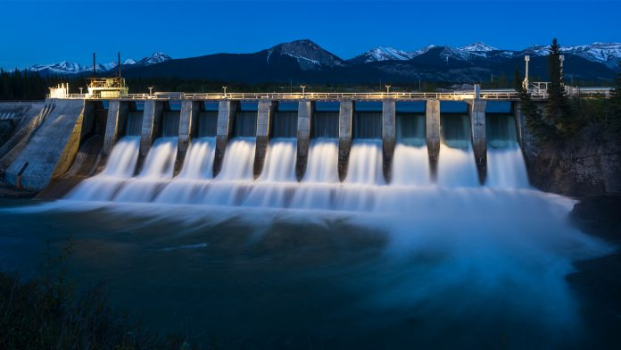
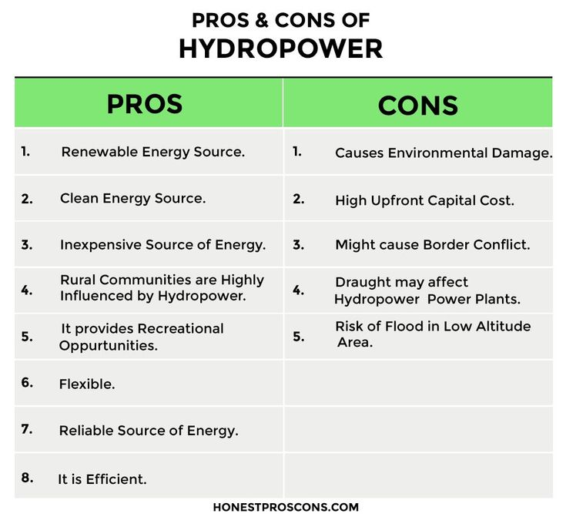
HYDROELECTRIC ENERGY
It’s a form of energy that uses the power of water in motion to generate electricity.
Water gains potential energy just before it spills over the top of a dam or flows down a hill. The potential energy is converted into kinetic energy as the water flows downhill. The water can be used to turn the blades of a turbine and generate electricity.

Slide 7
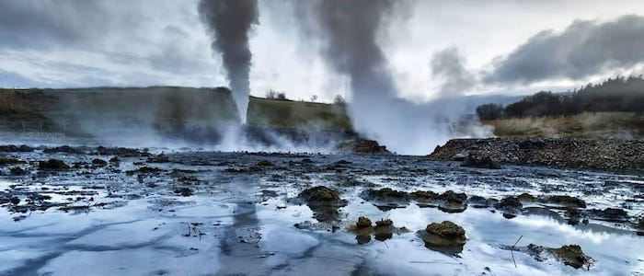
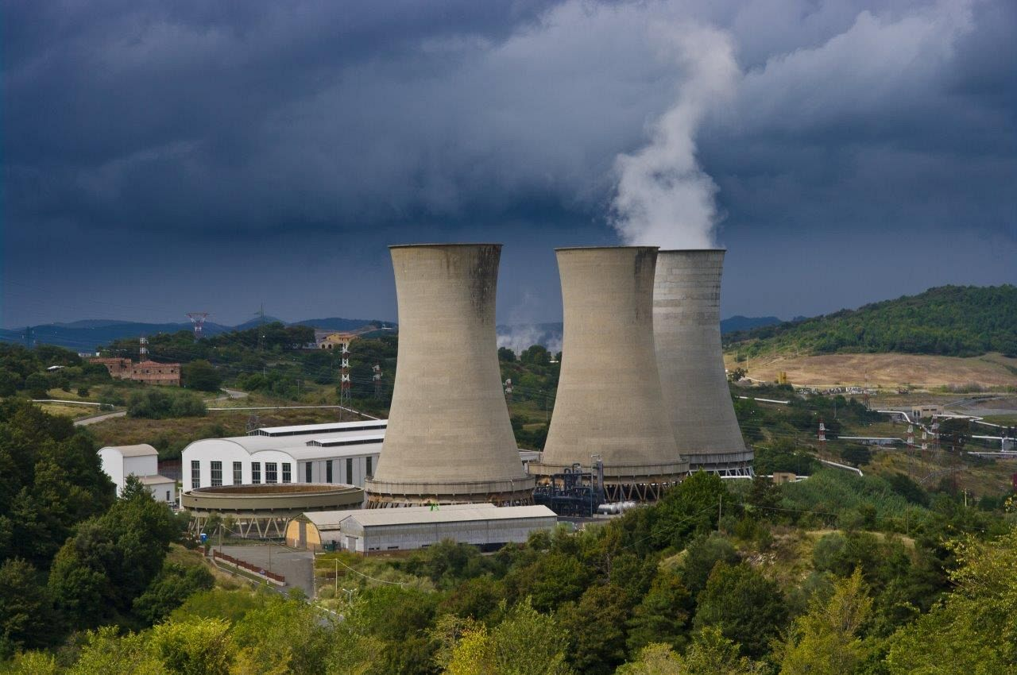
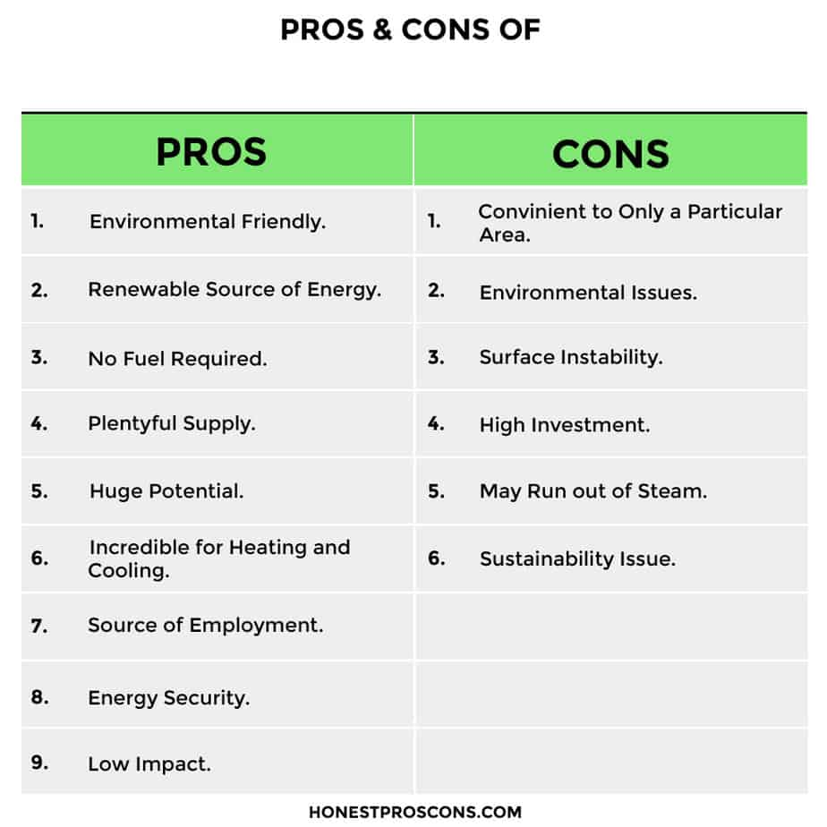
GEOTHERMAL ENERGY
Geothermal energy is a type of renewable energy taken from the Earth’s core. It comes from heat generated during the original formation of the planet and the radioactive decay of materials. This thermal energy is stored in rocks and fluids in the centre of the planet.

Slide 8
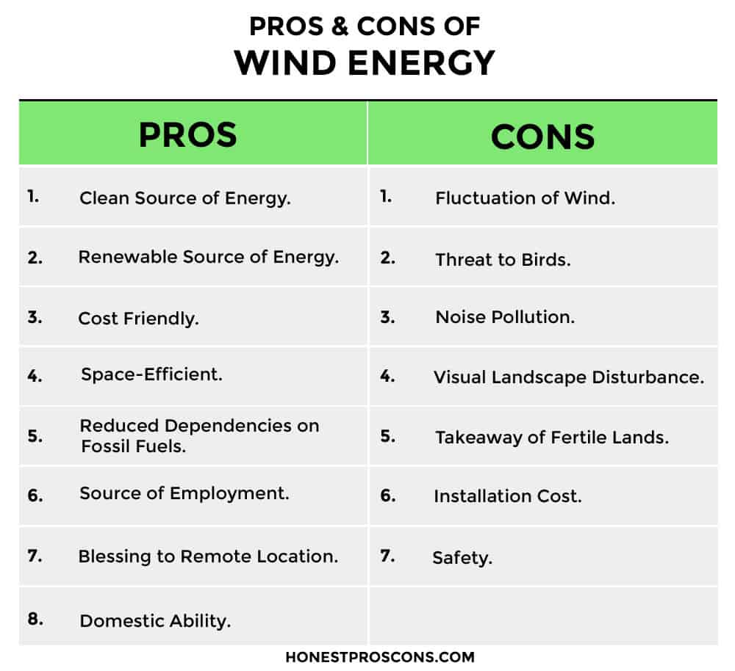
EOLIC ENERGY
Eolic energy is energy obtained from the force of the wind through a wind turbine that transforms the kinetic energy of air currents, into electricity;
The energy is mainly extracted with the rotor, which transforms the kinetic energy into mechanical energy, and with the generator, which transforms this mechanical energy into electricity.

Slide 9
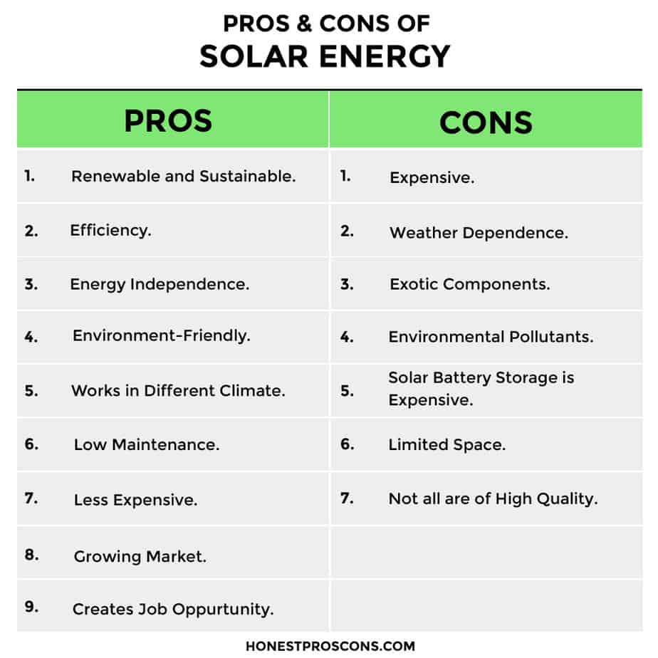
SOLAR ENERGY
Solar power is energy that is created by the sun and converted into usable energy that can provide electricity and heat. Solar energy is the cleanest form of energy and the most readily available. In fact, according to the US Department of Energy, enough sunlight strikes the earth's surface every hour and a half to power the entire world's energy consumption for a year.

Slide 10
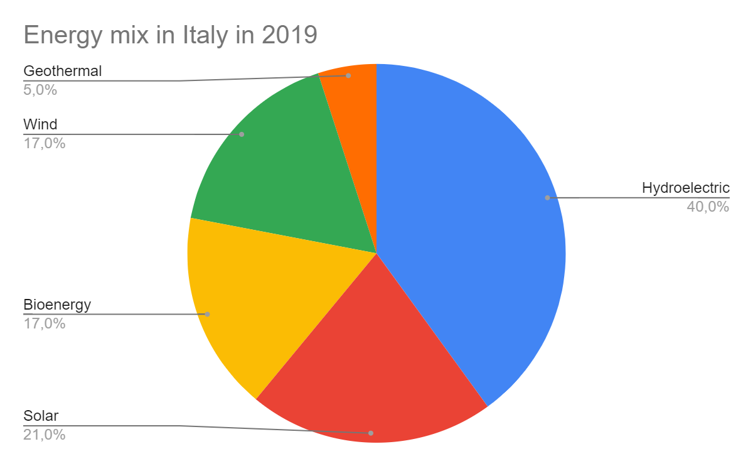
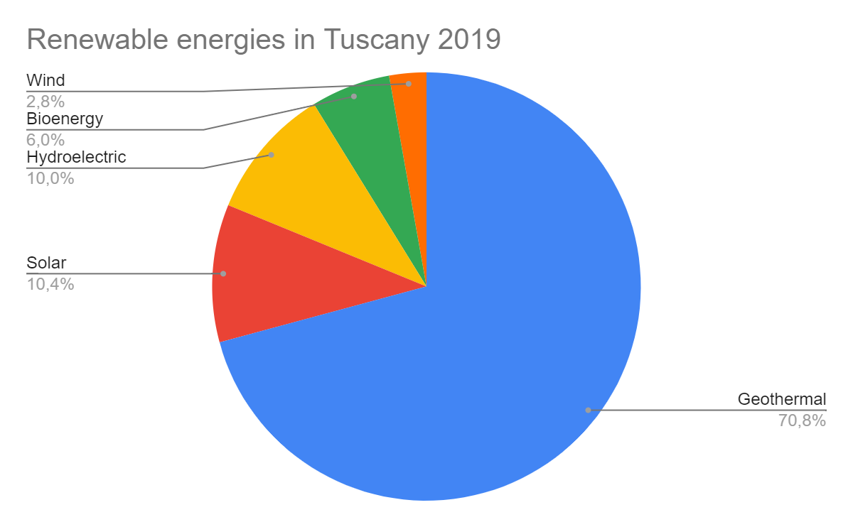
ENERGY USED IN ITALY and tuscany

Slide 11
Thanks for the attention
Misses Bennati and Rossetti, Niccolò Bandini, Giulio Bianchini, Giulia Bianciardi, Gaia Ceccherini, Samuele Coppi

